Slide 1
Object Oriented Programming in Python

Slide 2
OOPs Concepts
Encapsulation allows you to bundle data (attributes) and behaviors (methods) within a class to create a cohesive unit. By defining methods to control access to attributes and its modification, encapsulation helps maintain data integrity and promotes modular, secure code.
Inheritance enables the creation of hierarchical relationships between classes, allowing a subclass to inherit attributes and methods from a parent class. This promotes code reuse and reduces duplication.
Abstraction focuses on hiding implementation details and exposing only the essential functionality of an object. By enforcing a consistent interface, abstraction simplifies interactions with objects, allowing developers to focus on what an object does rather than how it achieves its functionality.
Polymorphism allows you to treat objects of different types as instances of the same base type, as long as they implement a common interface or behavior. Python’s duck typing make it especially suited for polymorphism, as it allows you to access attributes and methods on objects without needing to worry about their actual class.

Slide 3
Introduction
classes provide a sort of template for objects
instance of a class an object
Data members of an object are called instance data members or instance variables. Data items shared by all objects of a class are called class data members or class variables.
Data members can be accessible outside an object, or you can make them internal to the object for the private use of the methods inside the object.
Methods are the functions built into a class and therefore built into the objects you create from that class.

Slide 4
Object-oriented programming is a programming paradigm that provides a means of structuring programs so that properties and behaviors are bundled into individual objects.
For example, an object could represent a person with properties like a name, age, and address and behaviors such as walking, talking, breathing, and running. Or it could represent an email with properties like a recipient list, subject, and body and behaviors like adding attachments and sending.

Slide 5
Classes allow you to create user-defined data structures. Classes define functions called methods, which identify the behaviors and actions that an object created from the class can perform with its data.
Eg:
class Dog:
def __init__(self, name, age):
self.name = name
self.age = age
All dog objects must have a method called as __init__()
Every time you create a new Dog object, .__init__() sets the initial state of the object by assigning the values of the object’s properties. That is, .__init__() initializes each new instance of the class.

Slide 6
Inheritance
Inheritance is the process by which one class takes on the attributes and methods of another. Newly formed classes are called child classes, and the classes that you derive child classes from are called parent classes.
Eg :
Class parent:
  hair_color=“brown”
  spaeak=“English”
class Child(parent):
  pass

Slide 7
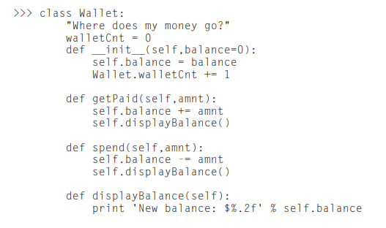

Classes

Slide 8
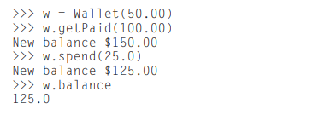
Creating Objects
To create an instance of a class, you “call” the class and pass in whatever arguments its __init__ method accepts, and you access the object’s attributes using the dot operator:
An instance of a class uses a dictionary (named __dict__) to hold the attributes and values specific to that instance. Thus object.attribute is the same as object.__dict__[‘attribute’]. Additionally, each object and class has a few other special members:

Slide 9
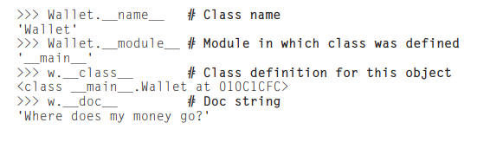

Slide 10
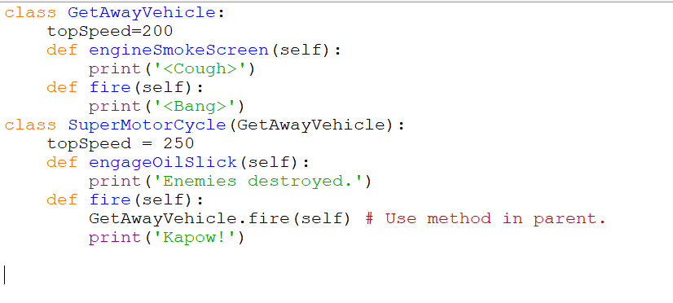

Slide 11
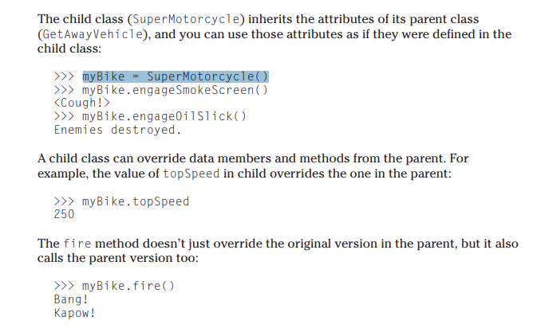

Slide 12
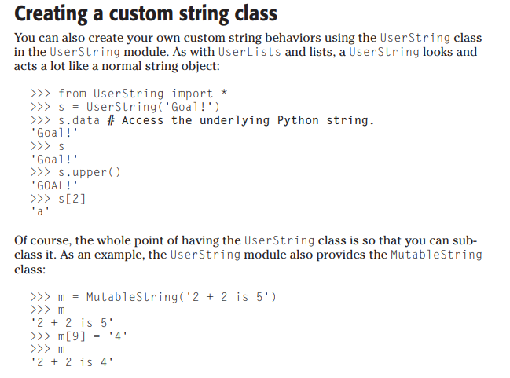

Slide 13
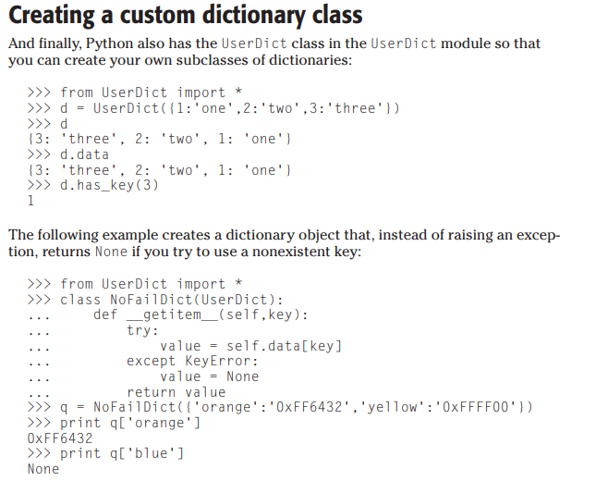

Slide 14
The End

